Slide 1



Staying Positive
The East Sussex Careers Hub
Support Material
Notes:
We hope these are useful to extend learning around this activity. Feel free to use these, or make a copy and edit as you wish. The resources are designed to support you and your school in achieving benchmarks 3 / 5 and 6, see last slide for additional activities and suggestions.
Transform essential skills
We have been inspired by the Essential Skills Framework, to bring you a series of videos of local East Sussex employers exploring how they use essential skills in their jobs and sectors.
The Skills Builder Universal Framework provides the national standard for teaching essential skills. It breaks each skill into steps, supporting progress for students of all ages and abilities - including those with special educational needs.
Staying Positive
The ability to use tactics and strategies to overcome setbacks and achieve goals
This skill is all about individuals being equipped to manage their emotions effectively and being able to remain motivated, and ultimately to motivate others, even when facing setbacks.
NOTE: Ahead of this lesson you may have wanted to deliver an assembly on this skill. See these free assemblies from SkillsBuilder:
https://hub.skillsbuilder.org/resources/?q=assembly?NSD

Slide 2
Job Sectors
Accountancy, banking and finance
Business, consulting and management
Charity and voluntary work
Creative arts and design
Energy and utilities
Engineering and manufacturing
Environment and agriculture
Healthcare
Hospitality and events management
Information technology
Law
Law enforcement and security
Leisure, sport and tourism
Marketing, advertising and PR
Media and internet
Property and construction
Public services and administration
Recruitment and HR
Retail
Sales
Science and pharmaceuticals
Social care
Teacher training and education
Transport and logistics
Notes:
From <https://www.prospects.ac.uk/jobs-and-work-experience/job-sectors>

Slide 3
LMI
Labour Market
LMI helps clients / customers to consider routes into and ways around and through the world of work, by raising aspirations, challenging stereotypes, increasing job knowledge and widening job knowledge.
LMI is essential for providing career and employment professionals with an understanding of the dynamic interplay between supply and demand in fast-changing local, regional, national and international labour markets.
Policy makers and planners need LMI to develop strategies for the labour markets of the future.
Course designers and curriculum developers use LMI to identify what knowledge and skills will be needed in the future.
Researchers use LMI in research and understanding economic and social development at national, regional and local levels.
Notes:
LMI is pivotal to effective careers practice because high quality, impartial, current, expert knowledge about the labour market distinguishes careers support from other types of helping.
A careers practitioner or teacher is likely to use LMI every time they interact with someone seeking help. Questions about course choice, self-employment, how much money could be earned in a particular job, where the local job vacancies can be found, what will the ‘hot jobs’ be when they leave education? None of these questions or issues could be addressed without LMI. LMI can help to demystify the world of work and can help individuals achieve their career goals.
In summary, LMI provides the knowledge and understanding of how the labour market functions and is crucial for making sense of changing economic circumstances. It can also help when thinking about what the future might hold, so can support career decision making.

Slide 4
Student Questions
What would your definition of Staying Positive be?
How many sectors did you see represented in the video?
Why is Staying Positive important in the different work settings?
How is Staying Positive as a skill, used in the workplace?
When do you use your Staying Positive skills in school?
Notes:
Here are some suggested answers which can also be seen by watching the video
1. Staying Positive
The ability to use tactics and strategies to overcome setbacks and achieve goals
This skill is all about individuals being equipped to manage their emotions effectively and being able to remain motivated, and ultimately to motivate others, even when facing setbacks.
2. See following slides
3. See following slides
4. See following slides for further detail.
NOTE : Please encourage your students to think about what they can see within the footage also, e.g. Paramedics communicate in a variety of ways, we can see through watching the video that radios are visible, hence listening is so vital

Slide 5
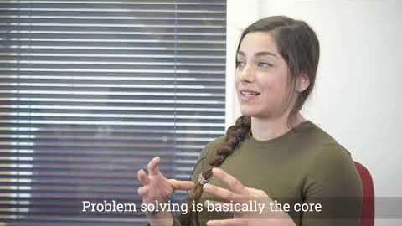
Notes:
https://youtu.be/xElHMbbbZ2k

Slide 6
Albion in the Community
Sports, Leisure and Tourism

Slide 7
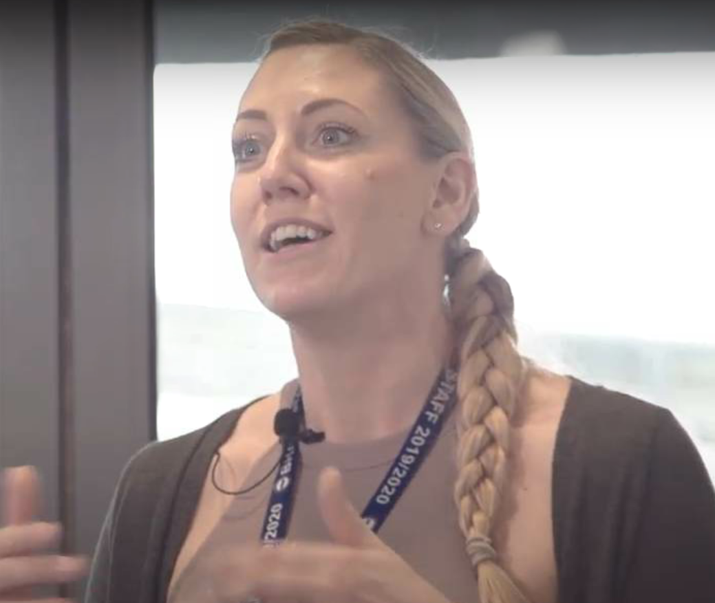
Schools Manager
Why is staying positive important in my job?
If I am constantly positive, the parents will be happy which means the children will be happy

Slide 8
Hastings Contemporary
Arts, Creative and Tourism

Slide 9
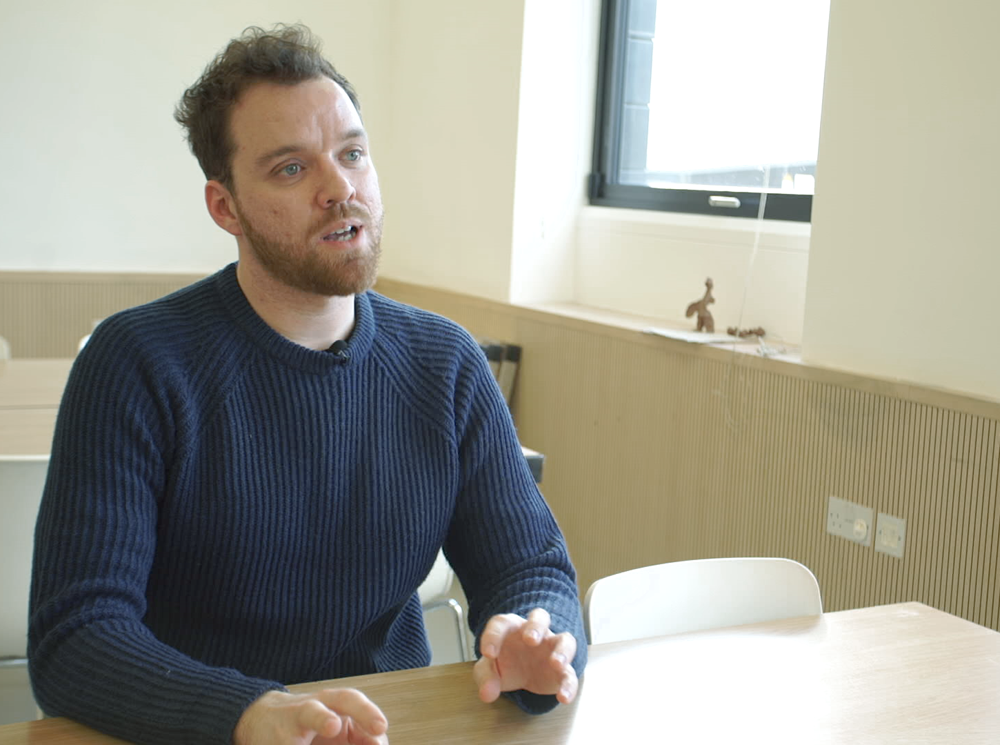
Education Officer
Why is staying positive important in my job?
In a small team the people that you work with pick up on your mood
If you stay positive you lift other people’s spirits

Slide 10
Hawes Building
Construction

Slide 11
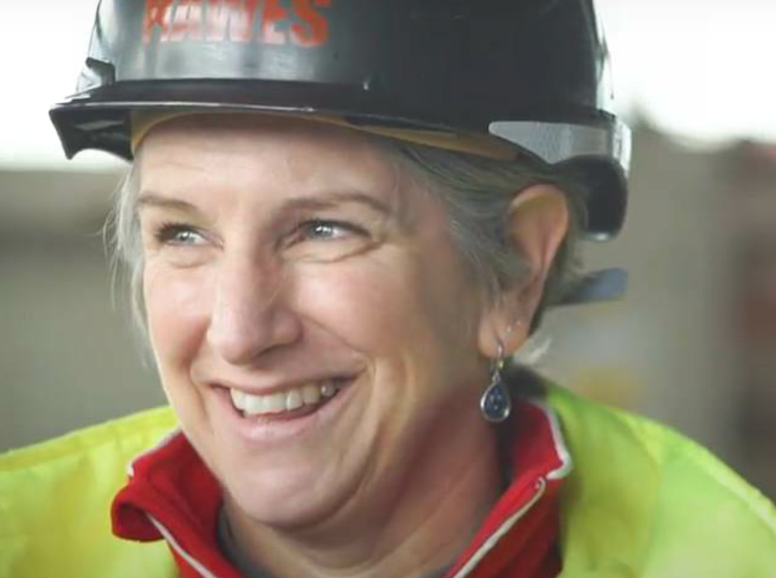
Construction Engineer
Why is staying positive important in my job?
Sometimes you need the workers to work longer hours and weekends
Bring the team on board by keeping language positive and rally together to get the job finished

Slide 12
South East Coast Ambulance Service (SECAmb)
Public Services and Healthcare

Slide 13

Paramedic
Why is staying positive important in my job?
We are with same person for 10-15 hours and need to stay positive
The job is tough and it is good to talk through things with colleagues

Slide 14
Surrey Nanosystems
Science and Pharmacetuicals

Slide 15

Research Scientist
Why is staying positive important in my job?
Most experiments don’t work out the way you want them to; it can be quite disappointing
Keep in mind the reason you are doing the research to get you through the hard experiments that don’t work

Slide 16
Hailsham Roadways
Construction and Engineering

Slide 17

Operations Manager
Why is staying positive important in my job?
Not everything goes well and that is just how life is. Turn your positivity on and start teambuilding, problem solving, being creative and you will find amazing solutions
Being a positive person means you can overcome issues and go home with a smile on your face ready for the next day

Slide 18

What additional skills would be important for these jobs?

Slide 19
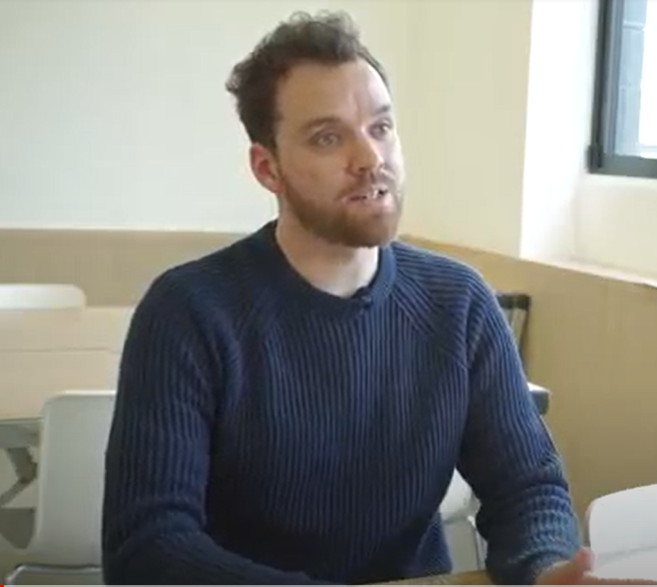
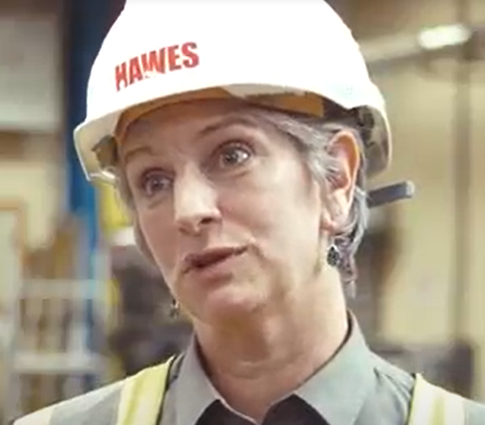
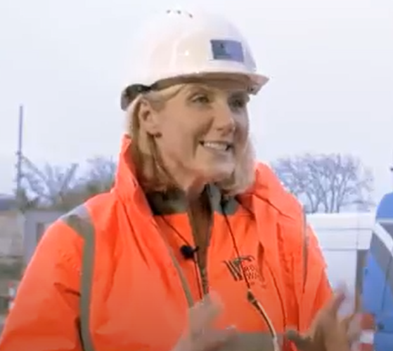
What additional skills would be important for these jobs?
Schools Manager
Education Officer
Teamwork
Listening
Construction Engineer
Leadership
Paramedic
Problem Solving
Research Scientist
Creativity
Operations Manager
Aiming High
Notes:
All of the essential skills are needed in every job role, some more than others perhaps.
The eight essential skills seen on the previous slide are known by many different names, these eight skills map across to the four domains that come up time and again as the core, transferable skills for employment.
In pairs they cover communication, creative problem-solving, self-management, and collaboration skills. These eight skills are laid out in the Skills Builder Universal Framework.
The Framework breaks down each of the eight essential skills into tangible steps which can be developed in turn. It can be used it to clarify what success looks like in each skill and to map out the trajectory for growth.
https://www.skillsbuilder.org/universal-framework/listening

Slide 20
Teachers Resources
Extension Activities
Students can work through the essential skills using the SkillsBuilder Passport
Link the lesson to an Open Doors activity or employer visit
Students work through the Careers East Sussex Employability Passport
Students complete a research task around a particular job or sector. Alternatively, use the Barclays Life Skills : Exploring job sectors and preparing for work lesson plan
Notes:
When could this session be delivered:
In tutor time
In PSHE
In a subject specific lesson
Embed the activities within your annual Career Programme
Use tracker to record activities and support Compass +
Ensure you have evaluated learning either before and at the end of the lesson, or at the beginning and end of the year
The skills videos can support you meeting Gatsby Benchmarks 4 / 5 and 6
To include an activity under Benchmark 5, it must meet the following minimum requirements:
There is evidence that the student actively participated.
Learning outcomes are defined, based on the age and needs of students.
The encounter involves two-way interaction between students and employers/employees.
To include an activity under Benchmark 6, it must meet the following minimum requirements:
Learning outcomes are defined, based on the age and needs of students.
Student meets a range of people from the workplace.
There is extensive two-way interaction between the student and employees.
Student must perform a task or produce a piece of work relevant to that workplace and receive feedback on it from the employer.

Slide 21
The East Sussex Careers Hub
www.careerseastsussex.co.uk
Notes:
Feel free to email enterprisecoordinator@eastsussex.gov.uk for further support

